Slide 1
Sources of Error
by
Dr. Md. Rajibul Islam
CSE, UAP

Slide 2
Sources of Error

Slide 3
Two sources of numerical error
Round off error
Truncation error

Slide 4
Round-off Error

Slide 5
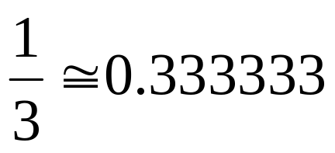
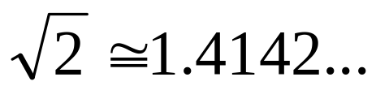
Round off Error
Errors created due to approximate representation of numbers

Slide 6
Effect of Carrying Significant
Digits in Calculations

Slide 7
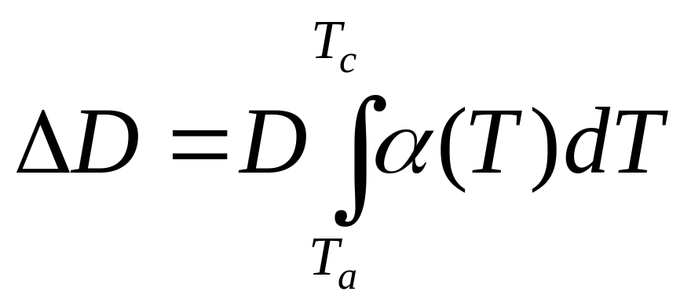
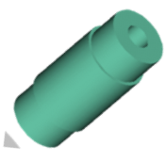
Find the contraction in the diameter
T_{a}=80ºF; T_{c}=-108ºF; D=12.363”
α = a₀+ a₁T + a₂T²

Slide 8
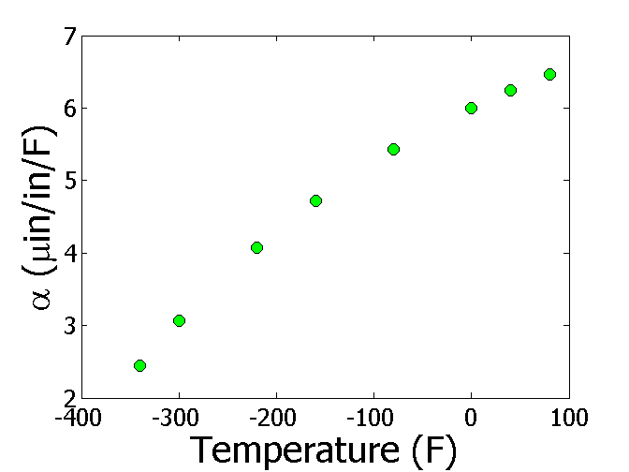

Thermal Expansion Coefficient vs Temperature
T(ºF) | α (μin/in/ºF)
-340 | 2.45
-300 | 3.07
-220 | 4.08
-160 | 4.72
-80 | 5.43
0 | 6.00
40 | 6.24
80 | 6.47

Slide 9
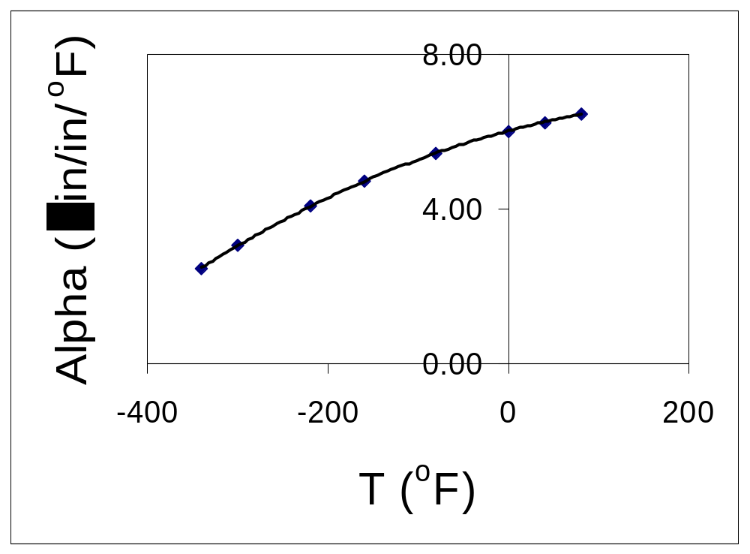
Regressing Data in Excel
(general format)
α = -1E-05T² + 0.0062T + 6.0234

Slide 10
Observed and Predicted Values
α = -1E-05T² + 0.0062T + 6.0234
T(ºF) | α (μin/in/ºF) Given | α (μin/in/ºF) Predicted
-340 | 2.45 | 2.76
-300 | 3.07 | 3.26
-220 | 4.08 | 4.18
-160 | 4.72 | 4.78
-80 | 5.43 | 5.46
0 | 6.00 | 6.02
40 | 6.24 | 6.26
80 | 6.47 | 6.46

Slide 11
Regressing Data in Excel
(scientific format)
α = -1.2360E-05T² + 6.2714E-03T + 6.0234

Slide 12
Observed and Predicted Values
α = -1.2360E-05T² + 6.2714E-03T + 6.0234
T(ºF) | α (μin/in/ºF) Given | α (μin/in/ºF) Predicted
-340 | 2.45 | 2.46
-300 | 3.07 | 3.03
-220 | 4.08 | 4.05
-160 | 4.72 | 4.70
-80 | 5.43 | 5.44
0 | 6.00 | 6.02
40 | 6.24 | 6.25
80 | 6.47 | 6.45

Slide 13
Observed and Predicted Values
α = -1.2360E-05T² + 6.2714E-03T + 6.0234
α = -1E-05T² + 0.0062T + 6.0234
T(ºF) | α (μin/in/ºF) Given | α (μin/in/ºF) Predicted | α (μin/in/ºF) Predicted
-340 | 2.45 | 2.46 | 2.76
-300 | 3.07 | 3.03 | 3.26
-220 | 4.08 | 4.05 | 4.18
-160 | 4.72 | 4.70 | 4.78
-80 | 5.43 | 5.44 | 5.46
0 | 6.00 | 6.02 | 6.02
40 | 6.24 | 6.25 | 6.26
80 | 6.47 | 6.45 | 6.46

Slide 14
Truncation Error

Slide 15
Truncation error
Error caused by truncating or approximating a mathematical procedure.

Slide 16

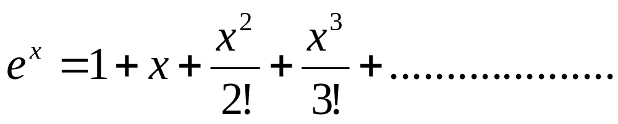
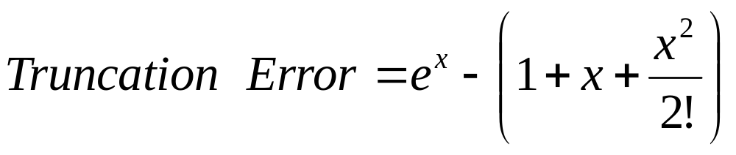
Example of Truncation Error
Taking only a few terms of a Maclaurin series to
approximate
If only 3 terms are used,

Slide 17

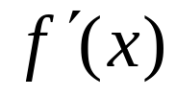
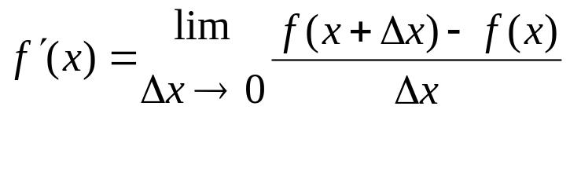
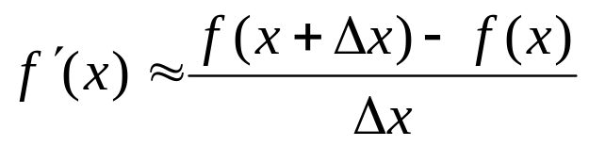
Another Example of Truncation Error
Using a finite
to approximate
secant line
tangent line
P
f(x+∆x)-f(x)
Q
∆x
x
x+∆x
Figure 1. Approximate derivative using finite Δx

Slide 18
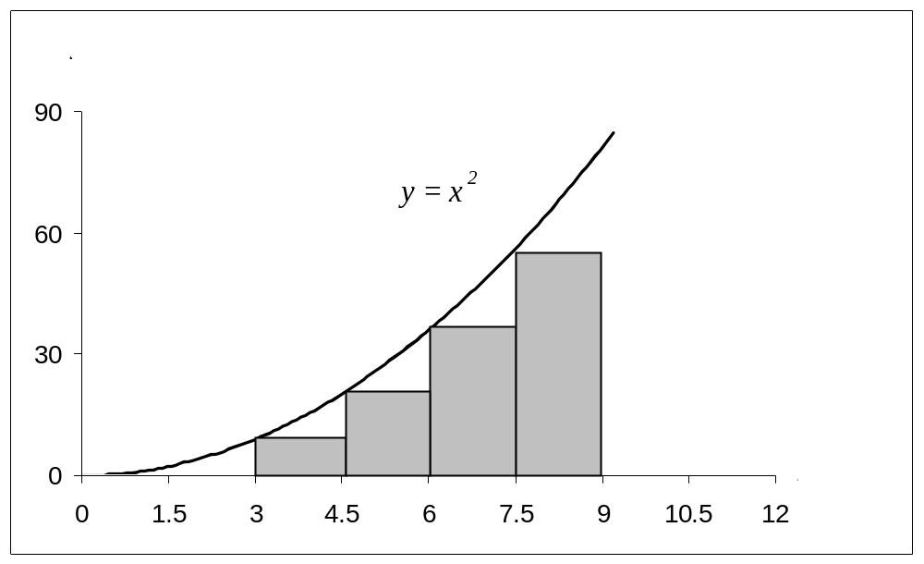
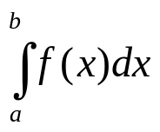
Another Example of Truncation Error
Using finite rectangles to approximate an integral.
f(x)
a
b
Need infinite number of rectangles
But to solve this numerically, we want to use a finite number of rectangles
Truncation error occurs

Slide 19
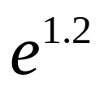
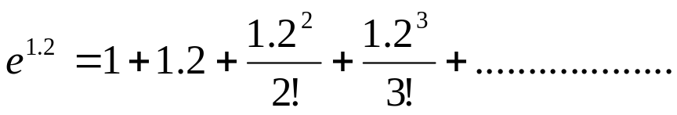

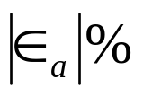
Example 1 —Maclaurin series
Calculate the value of
with an absolute
relative approximate error of less than 1%.
n
1 | 1 | __ | ___
2 | 2.2 | 1.2 | 54.545
3 | 2.92 | 0.72 | 24.658
4 | 3.208 | 0.288 | 8.9776
5 | 3.2944 | 0.0864 | 2.6226
6 | 3.3151 | 0.020736 | 0.62550
= Approximate error
= Relative approximate error
6 terms are required. How many are required to get at least 1 significant digit correct in your answer?

Slide 20



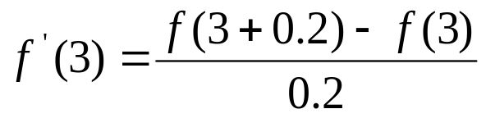
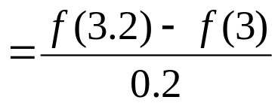
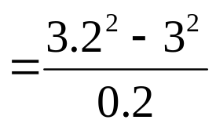
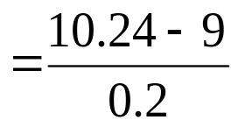
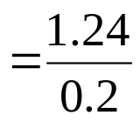






Example 2 —Differentiation
Find
for
using
and
The actual value is
Truncation error is then,
Can you find the truncation error with for

Slide 21
Test
Can you find the truncation error with
while finding
for
using
and

Slide 22
Additional Resources
Numerical Methods with Applications: Abridged (2nd Edition) – Autar Kaw, Egwu Kalu
  http://mathforcollege.com/nm/topics/textbook_index.html
Introductory Methods of Numerocal Analysis – S. S. Sastry

Slide 23
THE END

